Slide 1
Microglia regulation of sleep homeostasis
Joe Stucynski, QNC Presentation 1, 10/21/22

Slide 2
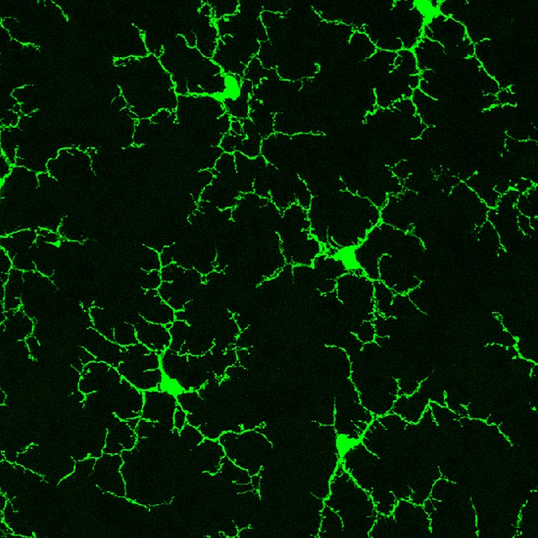
What are microglia?
Immune cells of the brain
2 active states
Immunologically active mode
Surveillance mode
Increasing evidence microglia are vital for brain health and CNS homeostasis in the absence of neural injury or infection
Roles in the healthy brain:
Pruning weak/silent synapses during both development and adulthood
Contributing to neuronal waste clearance
Modulating neural circuits
Spatial learning
Social behavior
Fear memory
Deurveilher et al. 2020

Slide 3
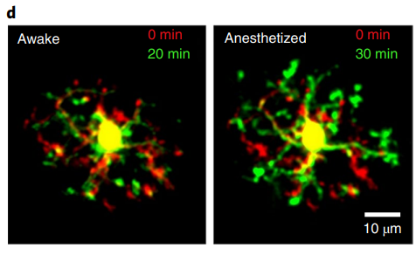
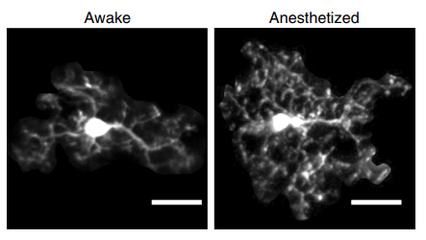
Microglial morphology varies across sleep and wake
Liu et al. 2019
Under control of Norepinephrine (coming from Locus Coeruleus)
Stowell et al. 2019

Slide 4
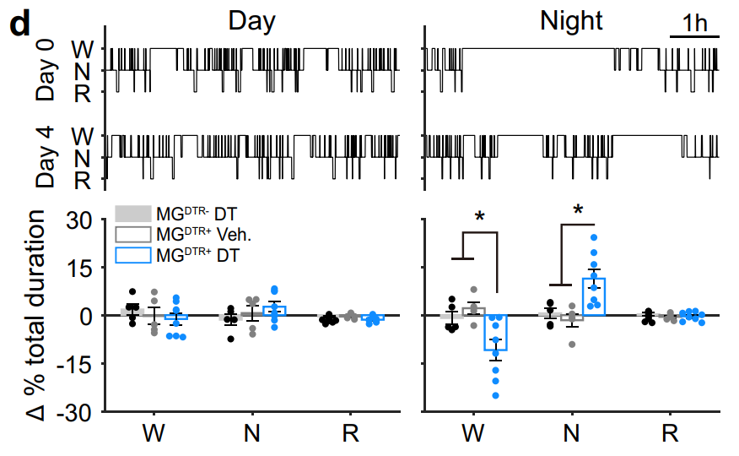
Microglia depletion affects sleep / wake architecture
Sleep period
Wake period
Loss of sleep/wake stability
Liu et al. 2021

Slide 5
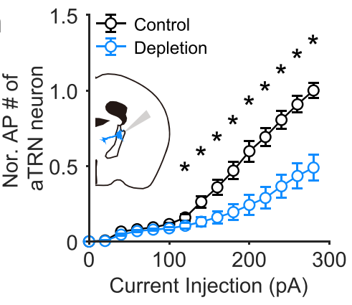
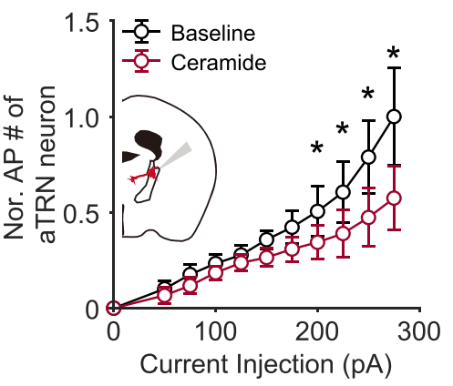
Microglia locally regulate sleep centers
Liu et al. 2021

Slide 6
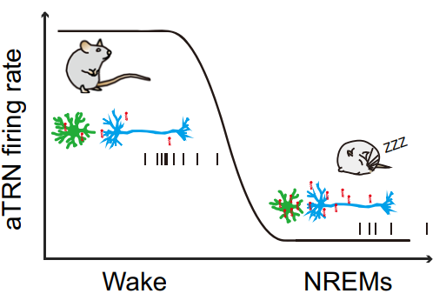
Microglia control diurnal rhythm of neuronal lipid byproducts in Thalamic Reticular Nucleus, affecting sleep
Wake:
Microglia retracted / not clearing
Ceramide levels low but gradually build up
TRN firing rate high to maintain stability of wakefulness
Sleep:
Microglia in surveillance mode
High ceramide build up inhibiting TRN thereby promoting sleep
Microglia actively clear ceramides during sleep
Liu et al. 2021

Slide 7
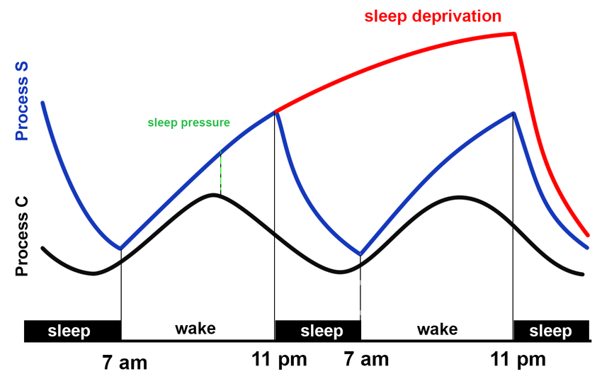
General Hypothesis: Microglia contribute to mechanisms of sleep homeostasis.
sleep rebound

Slide 8
General Hypothesis: Microglia contribute to mechanisms of sleep homeostasis.
sleep rebound
Significance: 1) Mechanisms of sleep homeostasis unclear.
2) Sleep quality, sleep homeostasis, microglia and lipid homeostasis are all dysregulated in aging and neurodegenerative diseases.

Slide 9
Measurement: Slow wave activity / delta power
EEG
EMG

Slide 10
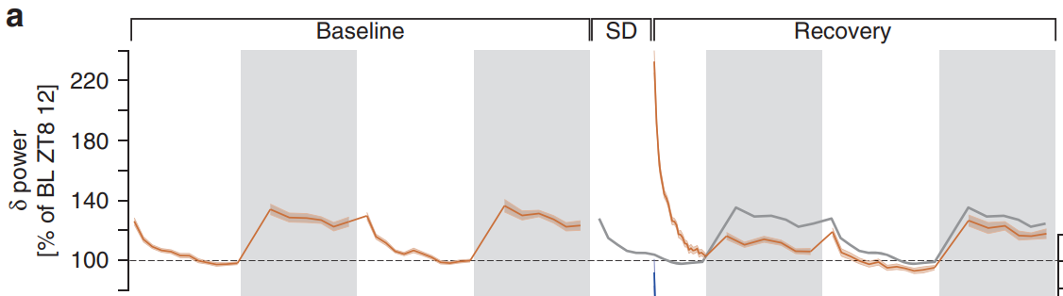
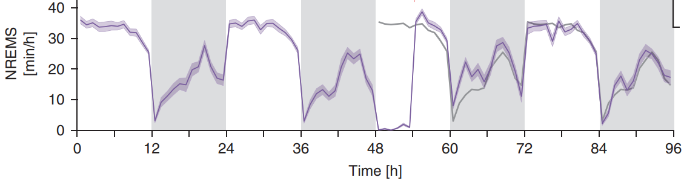
Slow wave activity during sleep is increased after sleep deprivation and slowly decays
Hubbard et al. 2020

Slide 11
Slow wave activity during sleep is increased after sleep deprivation and slowly decays
Hubbard et al. 2020

Slide 12
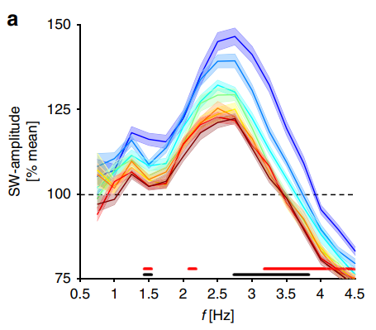
Slow wave activity during sleep is increased after sleep deprivation and slowly decays
1 hour
Hubbard et al. 2020

Slide 13
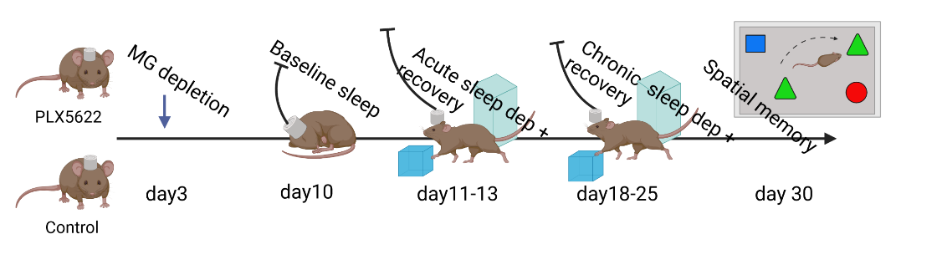
Experimental design
Day 1
Day 4
Day 5
Day 8, for 4 weeks

Slide 14
Experimental design
Day 1
Day 4
Day 5
Day 8, for 4 weeks
Dep.
Recovery
0
8
12
24
30
36
48
Post depletion baseline

Slide 15
Quantitative Hypothesis: Microglia depleted mice will exhibit elevated Delta Power during sleep and take longer to return to baseline than control mice.

Slide 16
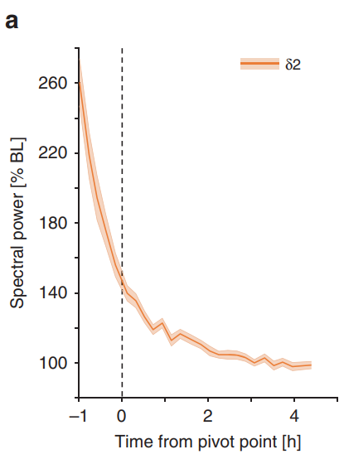
Analysis
Microglia depleted
Control

Slide 17
Analysis
Microglia depleted
Control
Unpaired t-test:
Is initial SWA significantly different between groups?
Is time to return to baseline significantly different between groups?
Is slope of SWA decay significantly different between groups?
Regression, or fit exponential curve and compare rate constants

Slide 18
Analysis
Microglia depleted
Two way Repeated Measures ANOVA
At what time points is the mean SWA power different between groups?
SWA amplitude across time and between conditions
Corrections for multiple comparisons (Bonferroni)
At what time points is the slope of the curve different between groups? → When is the rate of decay significantly different?
Control

Slide 19
Analysis
Microglia depleted, Chronic
Microglia depleted, Acute
Mixed ANOVA → Acute vs Chronic
Within condition sleep dep treatment, chronic vs acute
Between experimental treatment, control vs depleted
Pairwise T-tests with correction for multiple comparisons (Bonferroni)
Slope
Initial SWA amplitude

